Slide 1
N-bit Multiplier with Binary to BCD Converter
-By Akshata R G and Sangeeta R G

Slide 2
INTRODUCTION
This project is designed as an n-bit multiplier of two numbers. The multiplication is performed using the shift and add method of multiplying two numbers.
Once the multiplication is completed, the output result is also converted to its binary-coded decimal (BCD) representation.
This is done using the double dabble method of converting binary numbers to binary-coded decimal(BCD) .
In the output, the binary-coded decimal (BCD) representation is shown.

Slide 3
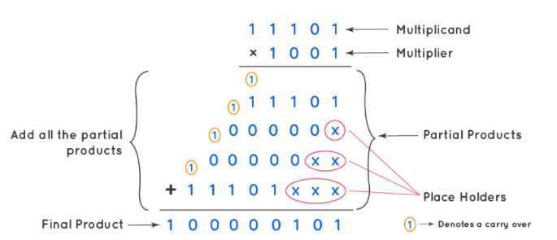
SHIFT AND ADD ALGORITHM
Consider two numbers 29 and 9
Their binary representation is 11101 and 1001
The result is 261
Their binary representation is 100000101

Slide 4

DOUBLE DABBLE ALGORITHM
Consider the number 151.
Its binary representation is 10010111

Slide 5
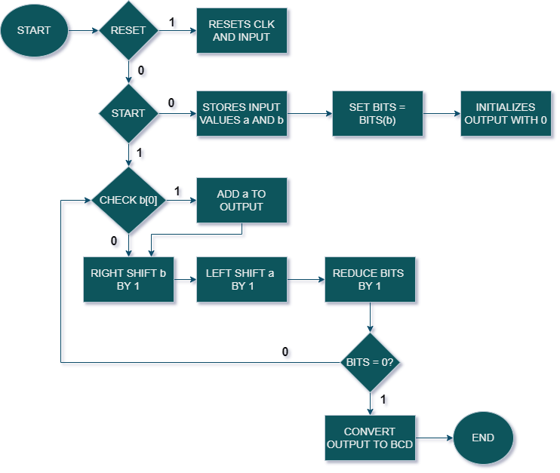
FLOW CHART

Slide 6
module multiplier(out, a_in, b_in, clk, start, reset, finish, bcd);
parameter N = 8;
// Outputs
output[(((N*2)/3)+1)*4-1:0] bcd;
output[(N*2)-1:0] out;
output finish;
// Inputs
input start;
input clk;
input reset;
input [N-1:0] a_in;
input [N-1:0] b_in;
// Reference registers
reg[(((N*2)/3)+1)*4-1:0] bcd_reg = 0;
reg[(N*2)-1:0] out_reg;
reg finish_reg = 0;
reg [(N*2)-1:0] a_in_reg;
reg [(N*2)-1:0] b_in_reg;
reg [8:0] bits;

Slide 7
// Continuous assignment
assign bcd = bcd_reg;
assign out = out_reg;
assign finish = finish_reg;
integer i, j;
// Reset clk and inputs
always @(negedge reset)
begin
out_reg=0;
a_in_reg=0;
b_in_reg=0;
end
always @(posedge clk)
begin
if(!reset)
begin

Slide 8
case(start)
1'b0: begin
a_in_reg = a_in;
b_in_reg = b_in;
bits = N;
finish_reg = 0;
out_reg = 0;
bcd_reg = 0;
$display("Values loaded into the input register!");
end
1'b1:begin
if(b_in_reg[0]==1)
begin
out_reg = out_reg + a_in_reg;
end
bits = bits - 1;
a_in_reg = a_in_reg<<1;
b_in_reg = b_in_reg>>1;
end
endcase

Slide 9
if(bits==0)
begin
$display("Multiplication completed!");
finish_reg = 1'b1;
for(i=0;i<(N*2);i=i+1)
begin
if (3 <= (((N*2)/3)+1)*4-1 && bcd_reg[3:0] >= 5) bcd_reg[3:0] = bcd_reg[3:0] + 3;
if (7 <= (((N*2)/3)+1)*4-1 && bcd_reg[7:4] >= 5) bcd_reg[7:4] = bcd_reg[7:4] + 3;
if (11 <= (((N*2)/3)+1)*4-1 && bcd_reg[11:8] >= 5) bcd_reg[11:8] = bcd_reg[11:8] + 3;
if (15 <= (((N*2)/3)+1)*4-1 && bcd_reg[15:12] >= 5) bcd_reg[15:12] = bcd_reg[15:12] + 3;
if (19 <= (((N*2)/3)+1)*4-1 && bcd_reg[19:16] >= 5) bcd_reg[19:13] = bcd_reg[19:13] + 3;
bcd_reg = bcd_reg[(((N*2)/3)+1)*4-2:0]<=out_reg[(N*2)-1-i];
end
$display("Conversion of binary to BCD completed!");
end
end
end
endmodule

Slide 10
TEST BENCH
module multiplier_tb;
parameter n_bits = 5;
// Inputs
reg [n_bits-1:0] a_in;
reg [n_bits-1:0] b_in;
reg clk;
reg start;
reg reset;
// Outputs
wire [(n_bits*2)-1:0] out;
wire finish;
wire [(((n_bits*2)/3)+1)*4-1:0] bcd;
// Instantiate the Unit Under Test (UUT)
multiplier uut (
.out(out),
.a_in(a_in),
.b_in(b_in),
.clk(clk),
.start(start),
.reset(reset),
.finish(finish),
.bcd(bcd)
);

Slide 11
defparam uut.N = n_bits;
initial
begin
forever
#50 clk= ~clk;
end
initial begin
// Initialize Inputs
a_in = 0;
b_in = 0;
clk = 0;
start = 0;
reset = 1;
// Wait 100 ns for global reset to finish
#100;
// Add stimulus here
reset = 0;
a_in = 'd26;
b_in = 'd30;
start = 0;
#200
start = 1;
#(100*n_bits)
a_in = 'd13;
b_in = 'd13;
start = 0;
#200
start = 1;
#(100*n_bits)
$finish;
end
endmodule

Slide 12
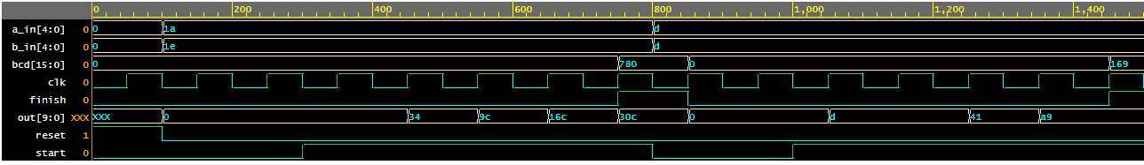
SIMULATION OUTPUT

Slide 13


